Slide 1
The Electronic Health System (EHR)
By Chris Comeaux
CSCE 221-507

Slide 2

What is the electronic heath record system?
Part “systematic collection of electronic health information about individual patients or populations” [2]
Part attribute-based encryption (ABE)
Part cloud computing
http://www.waspbarcode.com/buzz/electronic-health-records-efficiency-maintaining-patient-safety/

Slide 3
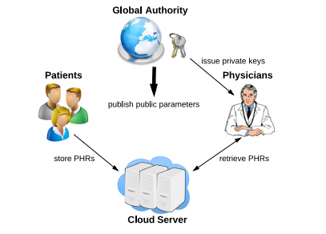
How it works
Patients: create their PHRs and upload them to a cloud server
Cloud Server: stores PHRs in a database and performs searches
Global Authority: key management
Private keys
Public keys
Master keys
Admin
http://ejournals.ebsco.com/Direct.asp?AccessToken=95IQ1I18XKIPDRM4Z1RI4XZU551E8DX19&Show=Object

Slide 4
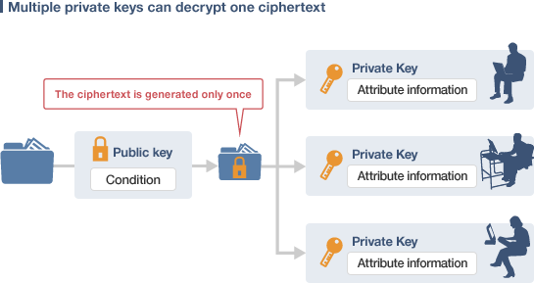
Attribute-Based encryption (ABE) Algorithms
Setup(λ): Setup algorithm – takes a security parameter as input and outputs a public key and a master secret key
KeyGen (Ikey, msk): Key Extraction algorithm - takes an access structure and master key as input and outputs a user’s private key
Encrypt (m, Ienc): Encryption algorithm – takes a message and attribute set and outputs the message in cyphertext
Decrypt (ct, sk): Decryption algorithm – Takes cyphertext and a users private key as input. If the private key is approved to view the attributes in the attribute set, the cyphertext will be decrypted and the PHR displayed. Otherwise, it outputs and error message (┴)
http://www.mitsubishielectric.com/company/rd/research/highlights/communications/function.html

Slide 5

EhR Cloud Storage
Stored in a secure location using tree structure
Linked by similar symptoms
Searched using Depth-First Search algorithm
https://www.linkedin.com/pulse/20140410210636-246665791-cloud-computing-security

Slide 6
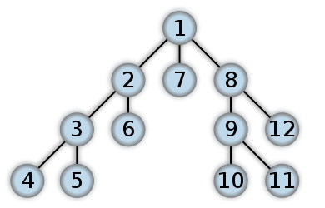
Depth-first Search algorithm
Search algorithm used to search tree or graph data structures
Steps:
First picks an arbitrary root
Next it traverses the left most branch until all nodes have been reached
Then it backtracks back up that branch to find any other nodes
Continues this process until all nodes have been searched
https://en.wikipedia.org/wiki/Depth-first_search

Slide 7
Depth-first search implementation
A doctor expresses his/her professional abilities as a set of symptoms (ω) into a template set (Ω). He/she then submits the set to the server.
The cloud server runs a depth-first search on all the PHRs on the cloud server with Ω as the parameter.
At the server level, the search compares the set of symptoms in each of the PHRs (ώ) to the imputed set. If |ώ∩ω| ≥ d, where d is a predefined number of similarities, the server decrypts the PHR and returns it to the physician.

Slide 8
Downsides
Since the algorithm has to visit every PHR on the server, the efficiency can be an issue.
The efficiency is O(l) where l is the number of PHRs on the server

Slide 9
Benefits to the EHR system
Easy and quick access to PHRs
Improves readability and eliminates bad penmanship
Cleaner for the environment and cheaper than original methods

Slide 10
Bibliography
Rosen, Kenneth H. "Trees." Discrete Mathematics and Its Applications. New York: McGraw-Hill, 2012. 787-89. Print.
Xhafa, Fatos1, fatos@lsi.upc.edu, et al. "Designing Cloud-Based Electronic Health Record System With Attribute-Based Encryption." Multimedia Tools & Applications 74.10 (2015): 3441-3458. Applied Science & Technology Source. Web. 24 Jan. 2016.
http://www.waspbarcode.com/buzz/electronic-health-records-efficiency-maintaining-patient-safety/
http://www.mitsubishielectric.com/company/rd/research/highlights/communications/function.html
https://en.wikipedia.org/wiki/Depth-first_search
https://www.linkedin.com/pulse/20140410210636-246665791-cloud-computing-security

